Slide 2
Call to Worship

Slide 3
Isaiah 66:1 – 2 (ESV)
66 Thus says the Lord: “Heaven is my throne, and the earth is my footstool; what is the house that you would build for me, and what is the place of my rest? 2 All these things my hand has made, and so all these things came to be, declares the Lord. But this is the one to whom I will look: he who is humble and contrite in spirit and trembles at my word.

Slide 4
Songs of Praise

Slide 5
A Mighty Fortress Is Our God

Slide 6
There’s A Wideness in
God’s Mercy

Slide 7
The Apostles’ Creed
I believe in God the Father Almighty, Maker of Heaven
and earth; And in Jesus Christ, His only Son, our Lord;
Who was conceived by the Holy Spirit, born of the
Virgin Mary, suffered under Pontius Pilate, was
crucified, dead, and buried; He descended into hell;
the third day He rose from the dead; He ascended into
Heaven, and sitteth on the right hand of God the Father
Almighty; From thence He shall come to judge the
quick and the dead. I believe in the Holy Spirit, the holy
catholic church, the communion of saints, the
forgiveness of sins, the resurrection of the body, and
the life everlasting. Amen.

Slide 8
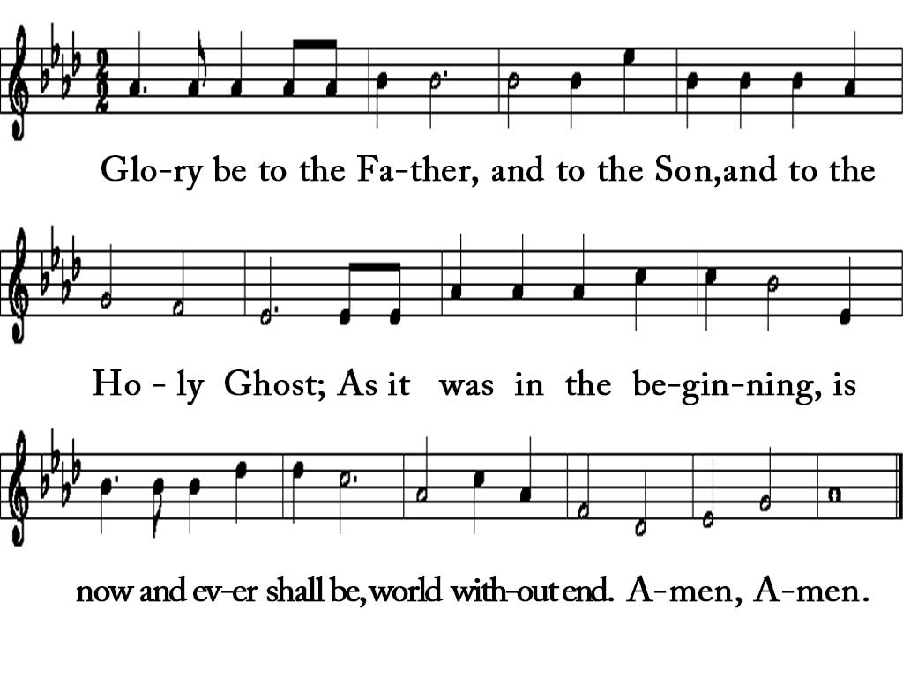
Gloria Patri

Slide 9
Sermon

Slide 10
“Who is God?”
“The Bible is the Story of God’s Mission”
“The Bible is the Story of God’s Mission”
“The Bible is the Story of God’s Mission”
“The Bible is the Story of God’s Mission”
“The Bible is the Story of God’s Mission”
“The Bible is the Story of God’s Mission”
“The Bible is the Story of God’s Mission”
“The Bible is the Story of God’s Mission”
“The Bible is the Story of God’s Mission”
“The Bible is the Story of God’s Mission”
“The Bible is the Story of God’s Mission”
“The Bible is the Story of God’s Mission”

Slide 11
God’s Mission
is the
redemption and the restoration
of all creation.

Slide 12
God speaks.
For example:
“Let there be light.”

Slide 13
God spoke and speaks
to and through prophets,
writers and individuals.

Slide 17
God’s Mission
has been through
Messianic prophesies

Slide 20
Writing the sacred Word or
speaking the prophecy did not mean
the writer or the speaker
was in full understanding
of what was said.

Slide 22
Jesus was referred to
as
“THE WORD”

Slide 23
John 1:1

Slide 24
Jesus is the Word
and
people proclaim God’s Word.

Slide 25
What is the difference
between
proclamation of God’s Word
and prophecy?

Slide 26
Proclamation is telling
truth to others.
Prophecy is foretelling
what will happen.

Slide 27
Prophecy was given
of
Jesus

Slide 28
The earliest prophecy
that was understood
to be referring to
Jesus
was in Genesis 3:15.

Slide 29
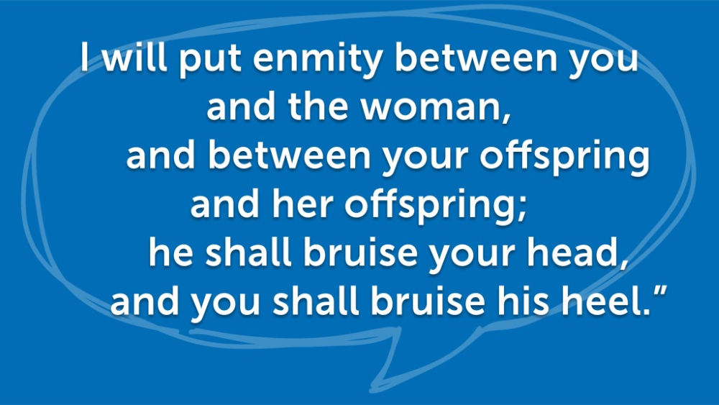
Genesis 3:15
Notes:
God spoke to the serpent (vv. 14–15), to Eve (v. 16), and to Adam (vv. 17–19). God’s words to the serpent included (a) the announcement that the snake, crawling and eating dust, would be a perpetual reminder to mankind of temptation and the Fall, and (b) an oracle about the power behind the snake.
Allen P. Ross, Genesis, in The Bible Knowledge Commentary: An Exposition of the Scriptures, ed. J. F. Walvoord and R. B. Zuck, vol. 1 (Wheaton, IL: Victor Books, 1985), 33.

Slide 30
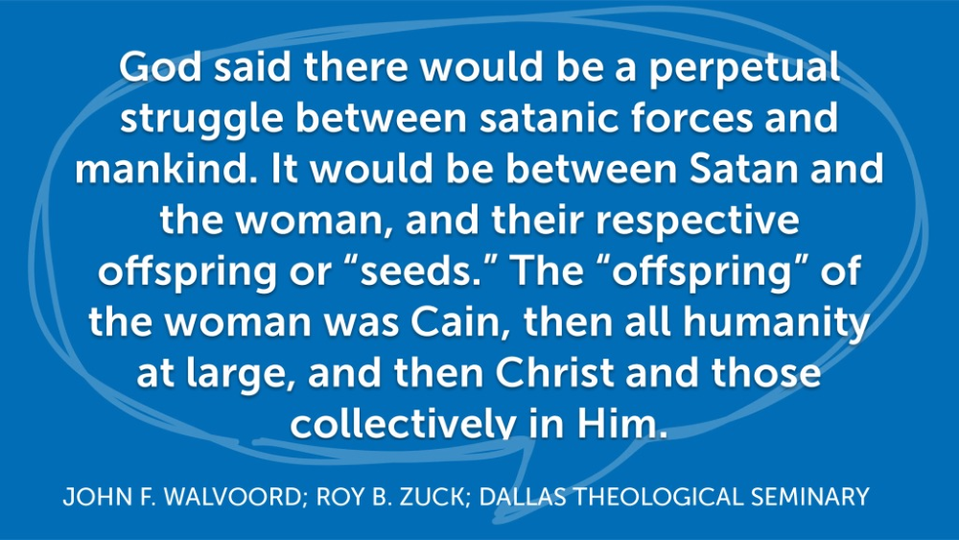
Notes:
Allen P. Ross, Genesis, in The Bible Knowledge Commentary: An Exposition of the Scriptures, ed. J. F. Walvoord and R. B. Zuck, vol. 1 (Wheaton, IL: Victor Books, 1985), 33.

Slide 31
Notes:
Allen P. Ross, Genesis, in The Bible Knowledge Commentary: An Exposition of the Scriptures, ed. J. F. Walvoord and R. B. Zuck, vol. 1 (Wheaton, IL: Victor Books, 1985), 33.

Slide 32
Among great prophesies,
there was no more magnificent prophesy
in the Old Testament than those that
spoke of the promised Messiah,
who would come to restore.

Slide 33
Isaiah foretold of
Jesus’ mission
to rule and establish
the kingdom of God.
(Isa. 9:6-7).

Slide 34
Isaiah proclaimed that Jesus
would not only restore just the Jews,
but he would bring light
for the Gentiles as well (Isa. 49:6).

Slide 35
Isaiah proclaimed suffering when he spoke
of the Servant of Yahweh (Isa. 53:3-10),
whom many scholars identify as Jesus Christ.

Slide 36
Humility was one characteristic
of Jesus’ mission, but Isaiah proclaimed
that Jesus was “a leader and commander
of the peoples” and “over all nations.”
(Isa. 55:4-5)

Slide 37
God’s mission of
redemption and restoration
through Jesus was planned
in the Old Testament.

Slide 38
Isaiah the prophet declared that
Jesus Christ was called to His mission
from the beginning of time,
“Listen to me, you islands; hear this,
you distant nations: Before I was born
the Lord called me; from my birth
He has made mention of my name.”
(Isa. 49:1)

Slide 39
The same message is repeated
in the New Testament.
“He was chosen before the creation
of the world but was revealed
in these last times for your sake.”
(1 Peter 1:20)

Slide 40
In the Gospel of John,
there are several times
where Jesus told the people
that God had sent Him to the earth
(John 7:28-29).

Slide 41
Jesus expressed that He was
sent to the earth by the Father,
but He also emphasized that
He was here to do the Father’s will.

Slide 42
One item of criteria for the direction
of Jesus Christ’s mission was
obedience to His Father’s will.
Jesus said, “For I have come down
from heaven not to do My will
but to do the will of Him who sent Me.”
(John 6:38)

Slide 43
Jesus’ visible
obedience to the Father
was a parallel to
His love of the Father
(John 14:31).

Slide 44
In the garden as Jesus was praying
and the soldiers were coming to arrest Him
Jesus said, “My Father, if it is possible,
may this cup be taken from Me.
Yet not as I will, but as You will.”
(Matt. 26:39)

Slide 45
Remember that Jesus
is the living example
that we are to follow.
That is why
we are to be known
as Jesus’ followers.

Slide 46
Jesus is the living example
of obedience to the Father’s will.
How are you doing following
Jesus’ example of obedience?
Do you desire to know and obey
the Father’s will?

Slide 47
The second criteria for the
direction of Jesus’ mission
was the fulfillment of the
Law and the Prophets.

Slide 48
Matthew recorded Jesus’ words,
“Do not think that I have come to
abolish the Law or the Prophets;
I have not come to abolish them
but to fulfill them.” (Matt. 5:7)

Slide 49
Once Jesus returned to Galilee and
went to the synagogue and He defined
His mission by reading Isaiah,
“. . . to preach good news to the poor.
He has sent me to proclaim freedom
for the prisoners and recovery of
sight for the blind, to release the oppressed,
to proclaim the year of the Lord’s favor.”
(Isa. 4:18-19)

Slide 50
Jesus fulfilled
the law and
the prophecies.

Slide 51
Other aspects of Jesus’ ministry
are those that were carried
on even after Jesus’ ascension.

Slide 52
Those aspects were
calling (Matt. 4:18-22),
commissioning (Mark 3:13-19)
and sending (Luke 10:1-23) out
His disciples so that they could
continue the ministry that
He demonstrated to them
during His time on earth.

Slide 53
Jesus lived the example
that he wanted
His disciples to follow.

Slide 54
Jesus asked these twelve men
to leave (their comfort zones)
and follow Him.
Jesus changed their lives,
and they were never the same.

Slide 55
Each one of us
can be on a journey of faith
as a follower of Jesus Christ.

Slide 56
Just as Jesus was sent
as a witness of the Father,
He sent out His disciples
to be His witness.

Slide 57
Jesus made disciples and likewise
those disciples have been told to
“go and make disciples.”

Slide 59
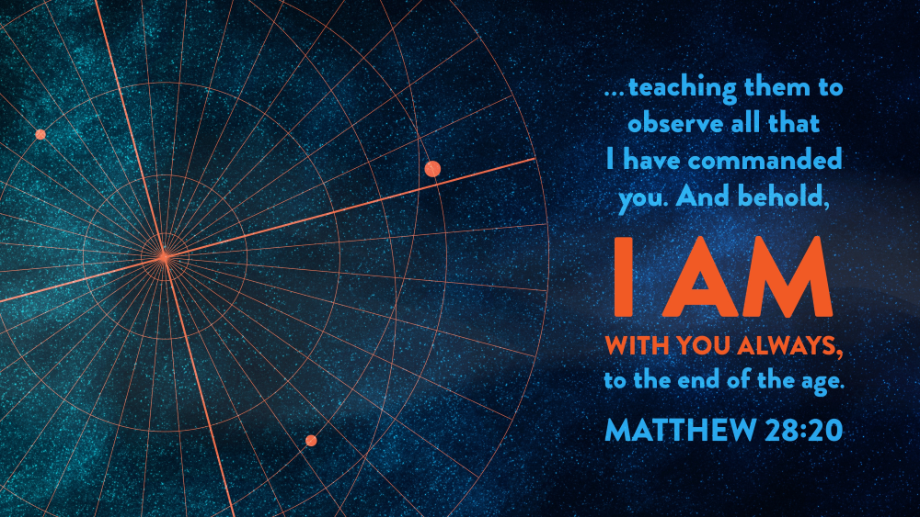

Slide 62
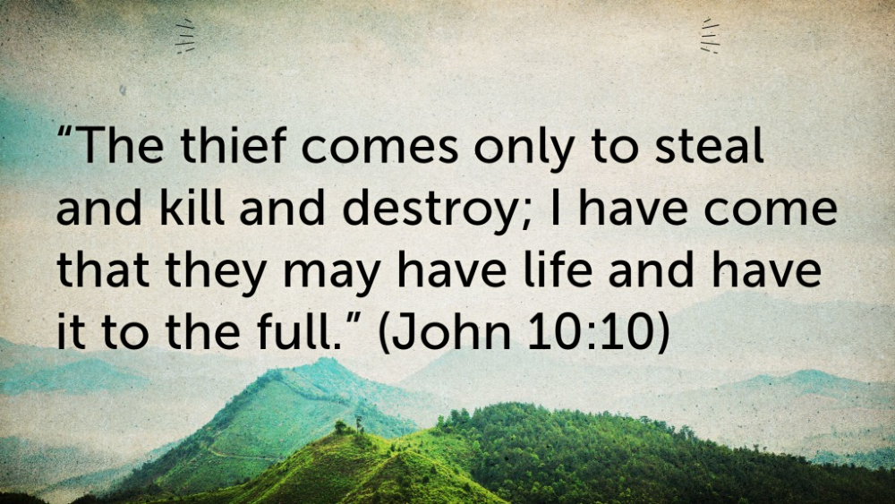

Slide 63
We want to know Jesus
and we want others
to know Jesus.

Slide 64
We need to continue to grow
in our knowledge and
share what we know
to others.

Slide 65
God speaks
to individuals
(personal story)

Slide 66
God is Lord!
Do you accept
God the Father
God the Son
and
God the Holy Spirit
as your LORD

Slide 67
Hymn of Commitment

Slide 68
Lord Dismiss Us with
Thy Blessing

Slide 69
Offering

Slide 70
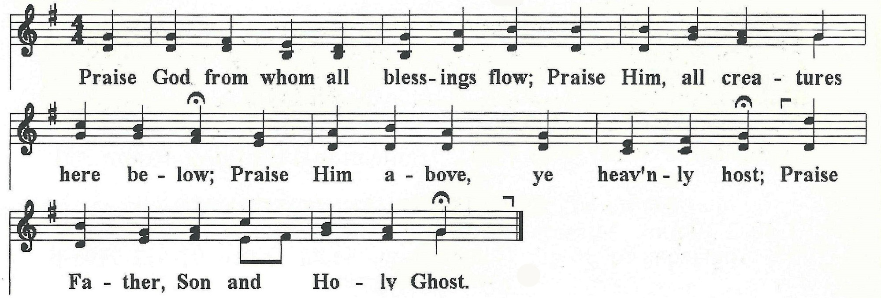
Doxology

Slide 71
Announcements &
Welcome of Guests

Slide 72
God Bless
Thanks for coming.

